Slide 1

ABE 715
Computer Programming
Lecture 2: Python Fundamentals
Variables, Data Types, and Operators
Dr. Kadeghe G. Fue
Department of Agricultural Engineering
1

Slide 2
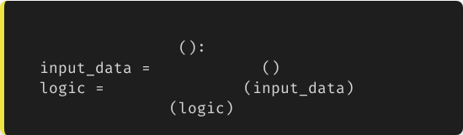

Recap: From Algorithms to Code
In Lecture 1, we discussed how engineering problems (like irrigation scheduling) are broken down into logical steps.
# The Engineering Workflow
Today, we start translating those steps into a language the computer understands: Python.
def
solve_problem
get_sensors
apply_formulas
actuate_system
Key Concept: Code is just a set of instructions. The syntax (grammar) must be perfect for the machine to execute it.
2

Slide 3

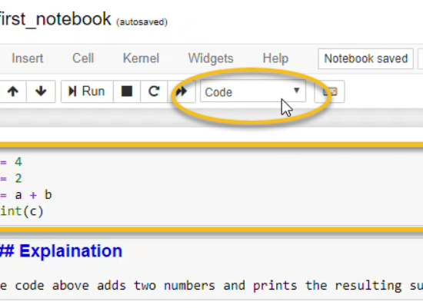
The Environment: Jupyter Notebooks
Where do we write code?
We will use Jupyter Notebooks (via Anaconda) for this course. It allows us to:
•
Write code in "Cells".
•
Run blocks of code individually.
•
Visualize data (charts) directly below the code.
•
Add documentation (Markdown) to explain our engineering logic.
3

Slide 4
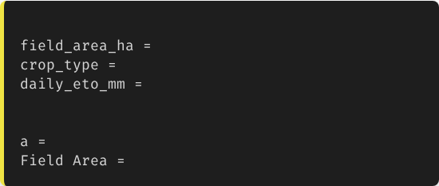
Variables: Containers for Data
Naming Conventions
A variable is a named storage location. In engineering, names matter.
# Good Naming
50.5
"Maize"
4.2
Use snake_case (lowercase with underscores).
# Bad Naming
Be descriptive. flow_rate_m3 is better than x.
50.5
# What is 'a'?
50.5
# Syntax Error (Spaces)
No spaces or special characters.
4

Slide 5
Primitive Data Types
Python automatically detects the type of data you assign to a variable.
Type | Keyword | Description | Example
Integer | int | Whole numbers (counts) | num_pumps = 3
Float | float | Decimal numbers (measurements) | temp_c = 28.5
String | str | Text characters | site_id = "Block_A"
Boolean | bool | True or False logic | is_active = True
5

Slide 6
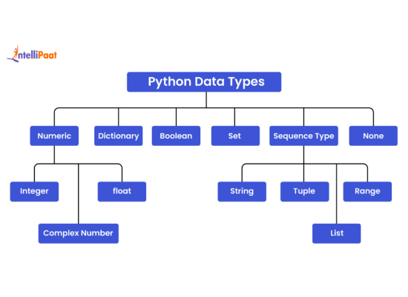
Visualizing Data Types
Conceptual Model
Think of variables as boxes in the computer's memory.
•
Int/Float: Boxes containing numerical values we can do math on.
•
String: A sequence of characters (letters/numbers) treated as text.
•
List (Advanced): A box containing multiple smaller boxes (like a vector).
6

Slide 7


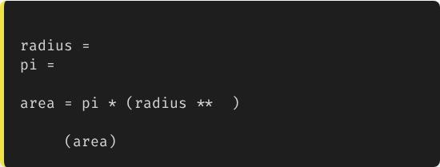




Arithmetic Operators
Python performs math just like a calculator.
# Calculating Area of a Circle
5.0
3.14159
2
print
# Output: 78.539...
7

Slide 8
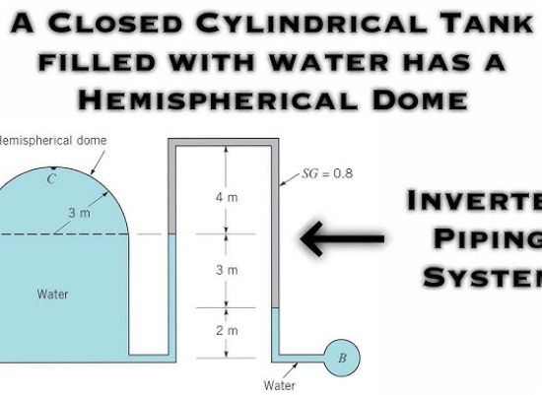
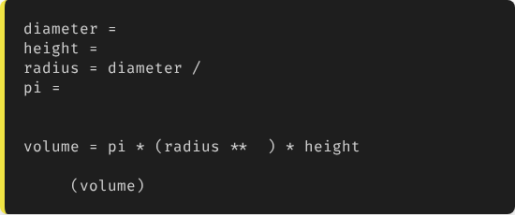
Applied: Tank Volume Calculation
Problem:
Calculate the water volume in a cylindrical tank with diameter 2m and height 5m.
2.0
5.0
2
3.14159
# V = π * r^2 * h
2
print
# Output: 15.707 m3
8

Slide 9
Comparison Operators
These operators compare two values and return a Boolean (True/False). Critical for if statements.
Operator | Meaning | Example | Result
== | Equal to | 10 == 10 | True
!= | Not Equal to | 10 != 5 | True
> | Greater than | soil_moisture > 30 | False (if 25)
<= | Less than or Equal | ph_level <= 7.0 | True
9

Slide 10

Interacting with Users
Input/Output (I/O)
Most programs need data from the "outside world" (User or Sensor).
•
input(): Pauses program and waits for user text.
•
print(): Displays information to the console.
•
f-strings: Formatted strings allow us to embed variables directly into text using {}.
10

Slide 11
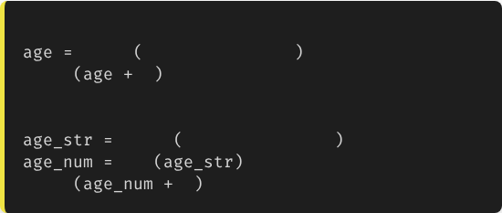
Type Casting (Conversion)
Warning!
# Wrong Way
input
"Enter years: "
# User types 2
The input() function always returns a String.
print
1
# Error! Cannot add int to str
# Correct Way
You cannot do math on a string ("5" + "5" = "55", not 10).
input
"Enter years: "
int
# Convert to Integer
We must cast (convert) the input to a number.
print
1
# Output: 3
11

Slide 12
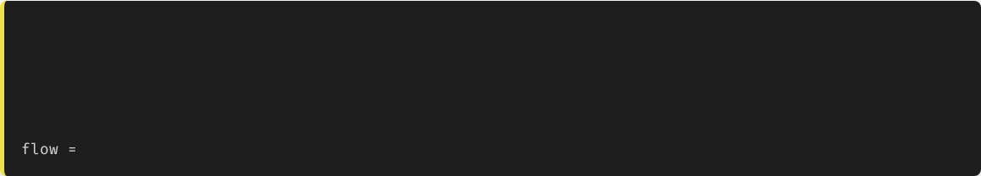
Writing Readable Code
Comments are for Humans
Code is read more often than it is written. In collaborative engineering projects, you must explain your logic.
# ------------------------------------------------
# IRRIGATION CALCULATOR V1.0
# Author: Eng. Juma
# Date: 2023-10-15
# ------------------------------------------------
10.5
# Flow rate in Liters/Hour
12

Slide 13

Lecture 2: Take-Home Assignment
Drip Irrigation Design Script
Task: Create a Python script that calculates the total number of drip emitters required for a rectangular field.
Requirements:
Use input() to ask the user for:
Field Area in Hectares (float)
.
Distance between plant rows in meters (float)
○
Distance between emitters along the row in meters (float)
○
Convert the input strings to float.
○
Calculate Total Emitters using:
Total = (Area_ha * 10000) / (Row_Spacing * Emitter_Spacing)
.
Use print() and an f-string to display the result (e.g., "You need 15000 emitters").
13
.

Slide 14
Questions?
Next Class: Control Flow (If/Else) and Logic
Dr. Kadeghe G. Fue
Department of Agricultural Engineering
14

